Slide 1


Saxo Service Blueprint: Present and Future
Enterprise Foundation

Slide 2





Enterprise Foundation Engineering
Oskar Kristiansen
Software Engineer
Travelling, boxing, cooking
Kristian Jensen
Senior Software Engineer
Fishing, nature, family
Jimmi Hested
Head of EFE
Football, family, technology
Ankur Singh
Senior Software Engineer
Cycling, travelling, driving
Jinhong Brejnholt
Product Owner
Cycling, table tennis, travelling

Slide 3


What doesn’t work
Production Environment

Slide 4
What doesn’t work
Production Environment

Slide 5

What doesn’t work
Complex and Inconsistent Process
Drift-Prone
Manual and Slow
Poor feedback
Difficult Disaster Recovery

Slide 6
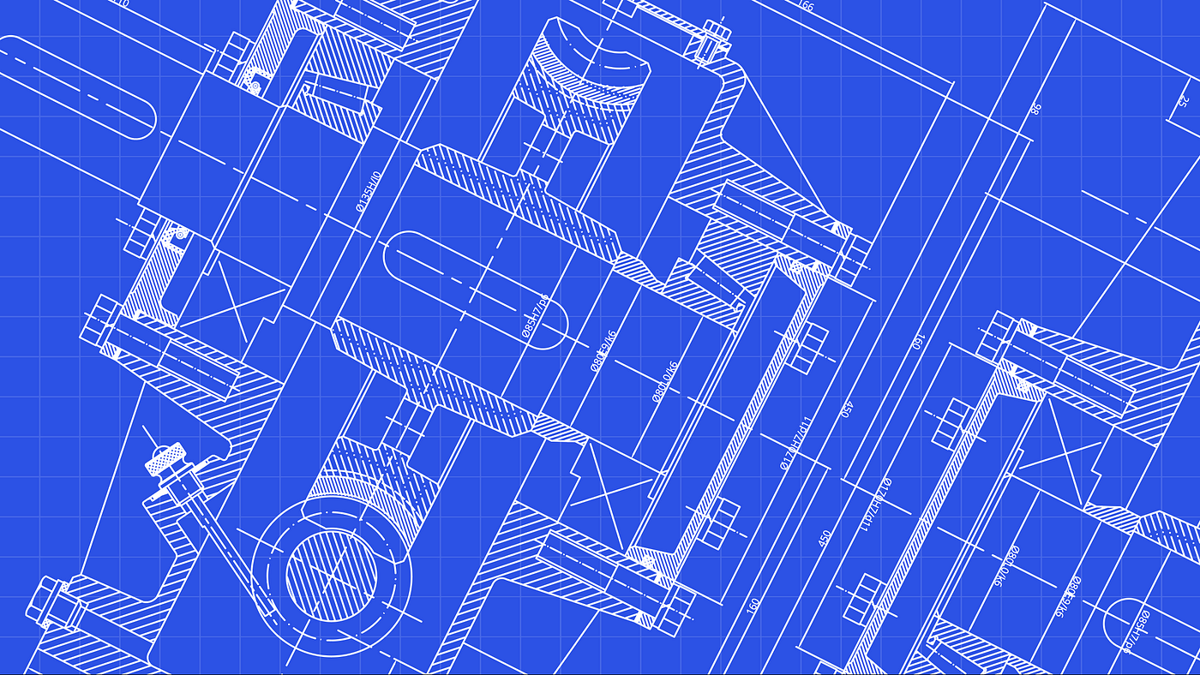

Saxo Service Blueprint
Notes:
Iac -> GitOps

Slide 7




Saxo Service Blueprint
Service

Slide 8

What may work ☺
Simple and Consistent Target – Git
Constant Reconcile
Automatic and Fast
Status visible at DevReach and Kubernetes
Built-in Disaster Recovery

Slide 9
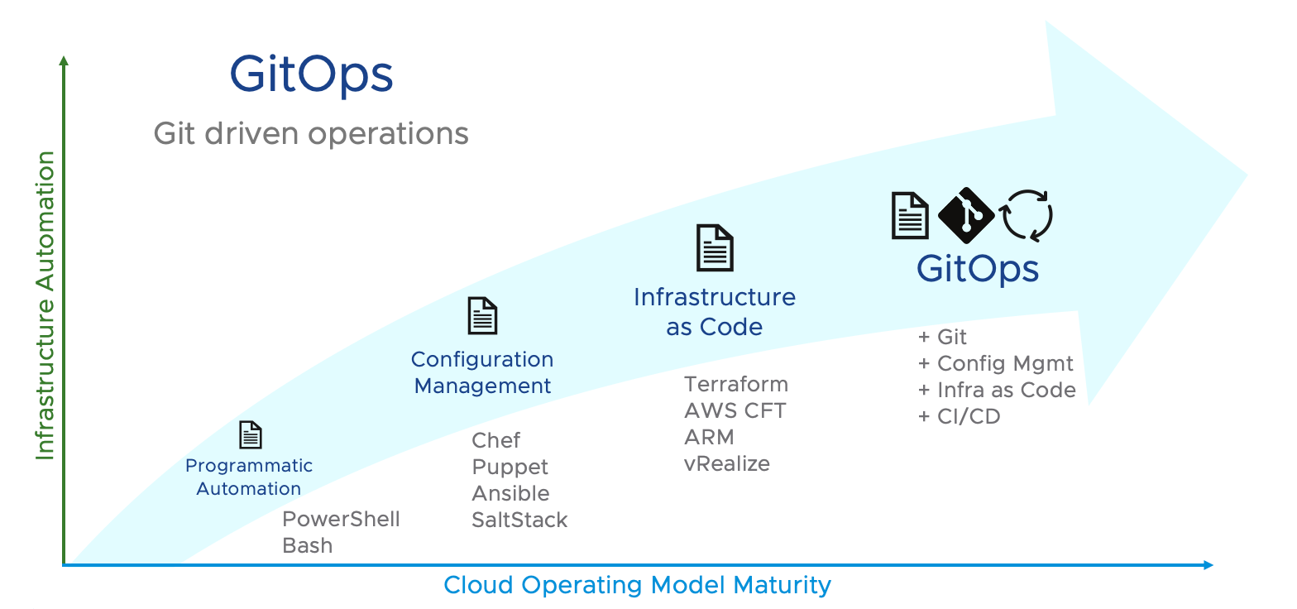

Slide 10
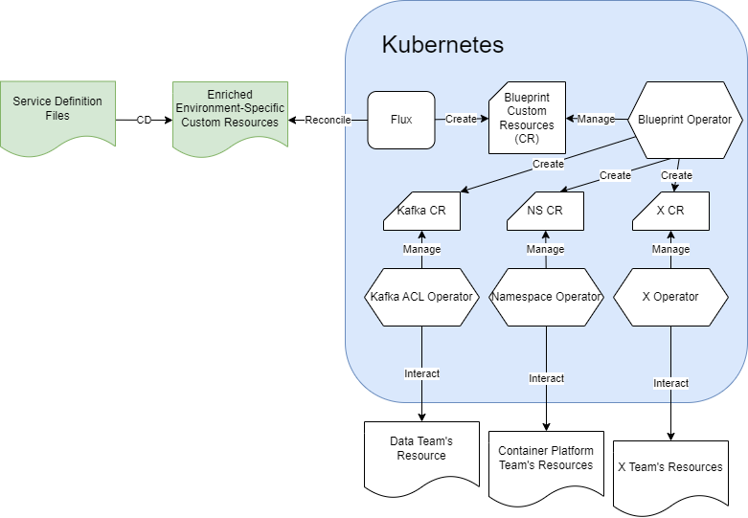
Saxo Blueprint Operators
Service

Slide 11
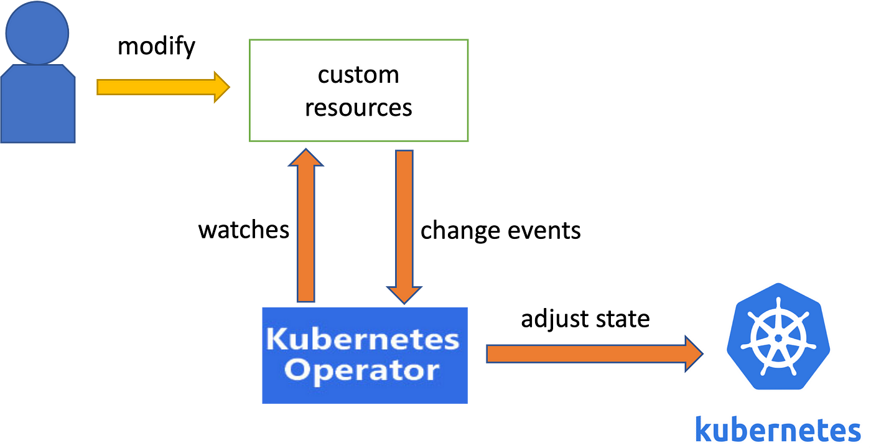
Operator Pattern
Notes:
Kubernetes has an ace up its sleeve that makes it even more useful, powerful, and flexible. That ace is called an Operator. Operators exist because Kubernetes was designed from the beginning for automation, which is built directly into the very heart of the software. In fact, Kubernetes allows users to automate the deployment and execution of workloads, and also the way that Kubernetes does these things.
This is why Operators are so powerful: they enable complex clusters and systems to operate automatically based on a set of patterns and principles. In short, Operators are patterns that extend the behavior of the cluster without changing the Kubernetes code. Its APIs act as custom resource controllers.
To understand the purpose of an Operator, we must first understand what it is. Then, we can understand how Kubernetes works and why Operators are so useful.

Slide 12




Automation & Identity Access Management

Slide 13
Organizational Structure
EFE
Data
App…
Container Platform Engineering
CCoE
Server Service

Slide 14
Organizational Structure
App…
EFE
Container Platform Engineering
CCoE
Server Service
Data

Slide 15
Organizational Structure
EFE
EFE
EFE
EFE
Data
App…
EFE
Container Platform Engineering
EFE
CCoE
Server Service
EFE
EFE

Slide 16

Collaboration

Slide 17

Collaboration

Slide 18

Q & A

